Slide 1
Workshop
Overview
Module 1: Overview of the Microsoft Azure Platform
Module 2: Building Application Infrastructure in Azure
Module 3: Hosting Web Applications on the Azure Platform
Module 4: Storing SQL Data in Azure
Module 5: Designing a Communication Strategy by Using Queues and Service Bus

Slide 2
Module 5:
Designing a Communication Strategy by Using Queues and Service Bus

Slide 3
Module 5 Overview
Lesson 1, Azure Storage Queues, introduces the queue mechanism that is available in Azure storage accounts.
Lesson 2, Azure Service Bus, introduces the Service Bus offering in Azure.
Lesson 3, Azure Service Bus Queues, describes the queuing mechanism that is available in Service Bus and how it differs from Azure Storage queues.
Lesson 4, Azure Service Bus Relay, describes the relay mechanism available to connect client devices to WCF services.
Lesson 5, Azure Service Bus Notification Hubs, introduces the Notification Hubs service and infrastructure useful for pushing notifications to mobile devices.
Objectives
After completing this module, you will be able to:
Describe Storage Queues service.
Describe Service Bus.
Describe Service Bus Queues service.
Describe Service Bus Relay.
Describe Notification Hubs service.

Slide 4
Module 5 Continued. . .
Azure Storage > Overview
Storage queues provide a consistent and reliable way to store messages that can be consumed by multiple workers.
This module introduces the Queue service in Storage and describes some of its characteristics.
Objectives
After completing this module, you will be able to describe the following Azure services:
Describe the Storage queues.
Describe the characteristics of Queue messages.
View messages in Storage queues.

Slide 5
Module 5 Continued. . .
Azure Storage > Using Azure Storage Blobs & Storage Tables Conceptually
VIDEO

Slide 6
Module 5 Continued. . .
Azure Storage > Storage Queues Overview
Storage Queues Overview
Queue is a service for storing large numbers of messages that can be accessed from anywhere in the world via authenticated calls using HTTP or HTTPS. A single queue message can be up to 64 kilobytes (KB) in size, and a queue can contain millions of messages, up to the total capacity limit of a storage account. A storage account can contain up to 200 terabytes (TB) of blob, queue, and table data.

Slide 7
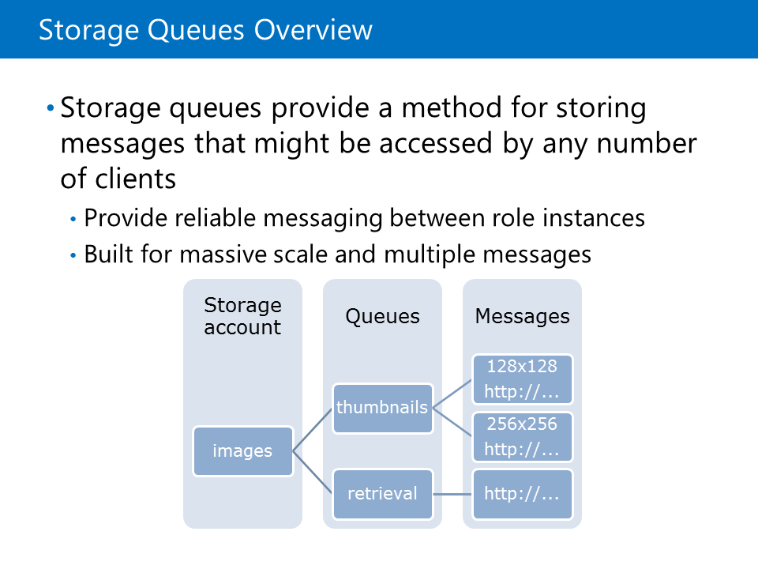
Module 5 Continued. . .
Azure Storage > Storage Queues Overview
Common uses of Storage queues include:
Creating a backlog of work to process asynchronously
Passing messages from an Azure web role to an Azure worker role

Slide 8
Module 5 Continued. . .
Azure Storage > Storage Queues Overview
The Queue service contains the following components:
URL format: You can address queues by using the following URL format:
http://<storage account>.queue.core.windows.net/<queue>
The following URL addresses one of the queues in the diagram:
http://myaccount.queue.core.windows.net/imagesToDownload

Slide 9
Module 5 Continued. . .
Azure Storage > Storage Queues Overview
Storage Account: All access to Storage is done through a storage account.
Queue: A queue contains a set of messages. All messages must be in a queue.
Message: A message, in any format, of up to 64KB.

Slide 10
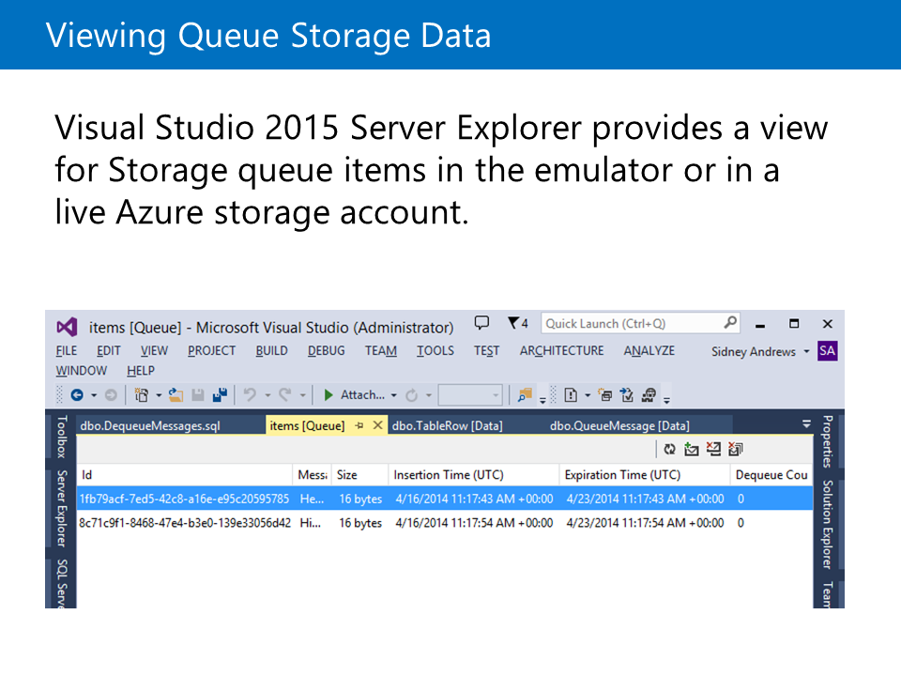
Module 5 Continued. . .
Azure Storage > Viewing Queue Storage Data
Starting with Microsoft Visual Studio 2015, the Server Explorer pane gives you the ability to manage and view Azure service instances directly within the IDE. You can view the messages within a queue by using the Server Explorer.

Slide 11
Module 5 Continued. . .
Azure Storage > Storage Queue Messages
Storage Queue Messages
The content in a queue message is stored as a string. You can store complex objects in a queue by serializing them as a string.

Slide 12
Module 5 Continued. . .
Azure Storage > Storage Queue Messages
Common Queue Message Actions
Add Messages - Messages can be added to the queue
Get Message or Messages - Retrieves the next message or messages from the queue and they will be invisible to other clients for a specified timeout period

Slide 13
Module 5 Continued. . .
Azure Storage > Storage Queue Messages
Peek Message or Messages - Retrieves the next message or messages from the queue while keeping the message or messages visible to other clients
Update Message - Updates the content or visibility timeout of a specified message
Delete Message - After a message is processed, you can delete the message from the queue so that it won’t be processed again.

Slide 14
Module 5 Continued. . .
Azure Storage > Storage Queue Messages
Timeouts and Idempotent Processing
Messages should be designed such that they can be processed multiple times without causing side effects. This occurs because a message might become visible to other queue clients if the visibility timeout elapses and the message that was retrieved is not deleted. Common scenarios where this might occur include worker role failure or transient service errors.

Slide 15
Module 5 Continued. . .
Azure Storage > Storage Queue Messages
Updating a Queue Message
Messages that exist in a queue are not static. You can change the contents of any message in a queue or modify the visibility timeout for an existing queue message. For example, if your application has a predicted failure, you can save the current status of a message that is being processed and either extend the visibility timeout or have the message handled by another worker instance.

Slide 16
Module 5 Continued. . .
Azure Storage > Storage Queue Messages
In a typical implementation, metadata about the amount of retried attempts for a queue message is stored in the message properties. This can help prevent an endless loop of processing a message that causes a particular application failure. Updating queue messages can also be used as a strategy for creating a multistep workflow on queue messages where they are handled by various different worker instances.

Slide 17
Module 5 Continued. . .
Azure Storage > Storage Queue Messages
Updating message content and making it visible immediately.
CloudQueueMessage message = queue.GetMessage();
message.SetMessageContent("Updated contents.");
queue.UpdateMessage(message,
TimeSpan.FromSeconds(0.0), // Make it visible immediately.
MessageUpdateFields.Content | MessageUpdateFields.Visibility);

Slide 18
Module 5 Continued. . .
Azure Storage > Securing Storage Assets
VIDEO

Slide 19
Module 5 Continued. . .
Azure Service Bus > Overview
Service Bus is a fully managed messaging platform in Azure. Components of your application can leverage Service Bus to share messages in a disconnected manner.
This module describes the Service Bus service and its features.

Slide 20
Module 5 Continued. . .
Azure Service Bus > Service Bus Overview
Different situations require different styles of communication. Sometimes, letting applications send and receive messages through a simple queue is the best solution. In other situations, where an ordinary queue isn't enough, a queue with a publish and subscribe mechanism is better. And in some cases, all that's really needed is a connection between applications—queues aren't always required for intermodule communication. Service Bus provides all three options, letting your applications interact in several different ways.

Slide 21
Module 5 Continued. . .
Azure Service Bus > Service Bus Overview
. . . Service Bus is a multitenant cloud service, which means that the service is shared by multiple users. Each user, such as an application developer, creates a namespace, and then defines the communication mechanisms he or she needs within that namespace.
Service Bus provides a multitenant service for connecting applications through the cloud.

Slide 22
Module 5 Continued. . .
Azure Service Bus > Azure Service Bus Overview
VIDEO

Slide 23
Module 5 Continued. . .
Azure Service Bus > Service Bus Features
Service Bus Features
Service Bus is composed of four communication services. You can create one or more instances of each service to connect toy our applications. These services include:
Queues. They act as an intermediary layer between your application components and store messages that other application components can receive.

Slide 24
Module 5 Continued. . .
Azure Service Bus > Service Bus Features
Topics. They are a one-directional communication mechanism that allow client applications or devices to subscribe to a topic. A separate application or device can publish messages to topics for consumption by the client applications.
Relays. They are a bidirectional proxy for communication with a Windows Communication Foundation (WCF) service. Client applications can bind directly to the relay endpoint and the relay infrastructure handles routing messages to the appropriate WCF service endpoint.

Slide 25
Module 5 Continued. . .
Azure Service Bus > Service Bus Features
Notification Hubs. It is a managed, brokered system for distributing messages from server applications to client devices across various platforms by using local notifications.

Slide 26
Module 5 Continued. . .
Azure Service Bus > Namespaces
Namespaces serve as a basic logical grouping of Service Bus service instances. When you create a queue, topic, or relay, you give it a name. The instance name is then combined the name of your namespace to create a unique identifier for the object. Applications can provide this name to Service Bus, and then use that queue, topic, or relay to communicate with one another. Service Bus namespaces can also contain management credentials, or shared keys, that your client applications can use to connect to Service Bus.

Slide 27
Module 5 Continued. . .
Azure Service Bus Queues > Overview
Service Bus provides the queue functionality that you can use to marshal messages from reporting applications to consuming applications. A Service Bus queue is different from a Storage queue.
This module describes Service Bus queues and the difference between Service Bus queues and Storage queues.

Slide 28
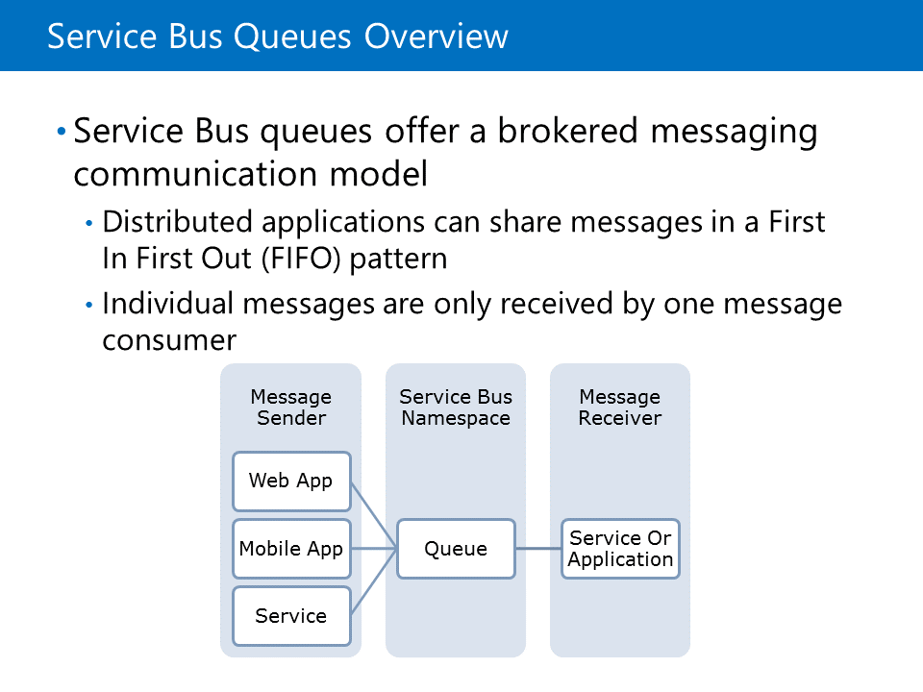
Module 5 Continued. . .
Azure Service Bus Queues > Service Bus Queues Overview
Service Bus Queue is a brokered messaging system, which is similar to the Queue service Azure Storage. By using these queues, application modules that are distributed do not need to communicate directly with each other.

Slide 29
Module 5 Continued. . .
Azure Service Bus Queues > Service Bus Queues Overview
These application modules can instead communicate by using the queues. This ensures that there is a separation between message generators and message processors. This separation provides the flexibility of having one or more application component instances that are generating messages and one or more application component instances that are processing the same messages. If an instance encounters an irrecoverable exceptional condition, other instances can continue processing the messages.

Slide 30
Module 5 Continued. . .
Azure Service Bus Queues > Service Bus Queues Overview
. . . If the workload for the entire application is increased, new instances can be created to handle the load. These scenarios are common and critical when developing and designing cloud applications.
Service Bus queues do implement a familiar first in, first out (FIFO) message delivery strategy. Service Bus queues can also guarantee that a message is received and processed both at least and at most once by the message consumers.
Service Bus queues provide one-way asynchronous queuing.

Slide 31
Module 5 Continued. . .
Azure Service Bus Queues > Service Bus Queues Overview
Service Bus queues are general-purpose :
Communication between web and worker roles in a multitier Azure application
Communication between on-premises apps and Azure hosted apps in a hybrid solution
Communication between components of a distributed on-premises application that is running in different organizations or departments of an organization.

Slide 32
Module 5 Continued. . .
Azure Service Bus Queues > Service Bus Queues
VIDEO

Slide 33
Module 5 Continued. . .
Azure Service Bus Queues > Queue Message Delivery
Queue Message Delivery
Messages in a Service Bus queue are delivered and handled in a common, predictable pattern. First, a message generator creates a new message and adds the message to a queue. A receiver can process this message at a later time. Many receivers can process messages in the same queue, but they do not share these messages in a multicast scenario. Messages are typically processed by only one receiver unless there is an exception condition.

Slide 34
Module 5 Continued. . .
Azure Service Bus Queues > Queue Message Delivery
. . . When a receiver reads a message, it has two options to handle the message. The receiver can first choose the ReceiveAndDelete method. This method removes the message from the queue and deletes it after it is read. The risk with using this method is that the message can be lost if there is an error with the receiver's application. Alternatively, the receiver can choose to use the PeekLock method. This method still removes the message from the queue but it does not delete the message.

Slide 35
Module 5 Continued. . .
Azure Service Bus Queues > Queue Message Delivery
. . . This method still removes the message from the queue but it does not delete the message. The message is instead locked and is flagged as not visible to other receiver instances. This lock can be handled in three ways:
If the message is successfully processed, the Complete method is used to instruct the queue to delete the message immediately.

Slide 36
Module 5 Continued. . .
Azure Service Bus Queues > Queue Message Delivery
If the message has failed at some point in processing but the application can handle this failure without crashing, the Abandon method is used to indicate that the lock should be removed from the message. The message will now be visible to other receivers that wish to process the message.
If the configured time-to-live value for the queue message expires, the queue assumes that the receiver is in a faulted state. The queue removes the lock from the message and makes it available to other receivers.

Slide 37
Module 5 Continued. . .
Azure Service Bus Queues > Queue Message Delivery
. . . After a receiver application component reads the message, it is the responsibility of the receiver to call the Complete method after the message is successfully processed. If this does not occur, an infinite loop can happen where the same message is processed infinitely because of the time-to-live period expiring for the message. Service Bus Queue messages have a unique ID that your client application can use to determine if a message is processed by more than one receiver.

Slide 38
Module 5 Continued. . .
Azure Service Bus Queues > Characteristics of Service Bus Queue Messages
Characteristics of Service Bus Queue Messages
If you use the .NET libraries for Azure, you must use the BrokeredMessage class to represent the Service Bus Queue messages. The BrokeredMessage class includes standard properties that represent metadata that is pertaining to the individual message.

Slide 39
Module 5 Continued. . .
Azure Service Bus Queues > Characteristics of Service Bus Queue Messages
These properties include:
Label. This property that can be used by your applications to provide details and simple labels for messages.
TimeToLive. You can use this property to indicate the duration that a message should be persisted in the message store.
MessageId. You can use this property to provide a unique identifier for the message.

Slide 40
Module 5 Continued. . .
Azure Service Bus Queues > Characteristics of Service Bus Queue Messages
The message object also includes a dictionary property named Properties. This IDictionary<string, object> typed property can contain any custom properties that you want to define for your application. These properties are included in the object in addition to the actual body of the message. The message body is a Common Language Runtime (CLR) object that is serialized by using DataContractSerializer.

Slide 41
Module 5 Continued. . .
Azure Service Bus Queues > Characteristics of Service Bus Queue Messages
. . . After you create a new BrokeredMessage instance, you can add the message body by using the GetBody<T> method of the BrokeredMessage class. Because the body is serialized, this can be any complex object that you want to transmit from your sender application to receiver applications. Additional metadata about this message is typically stored in the Properties property of the BrokeredMessage class.

Slide 42
Module 5 Continued. . .
Azure Service Bus Queues > Characteristics of Service Bus Queue Messages
This example demonstrates how to send five test messages to a QueueClient instance.
New BrokeredMessage
BrokeredMessage message = new BrokeredMessage("Test message ");
message.Properties["TestProperty"] = "TestValue";
message.Properties["Message number"] = 12;
Client.Send(message);

Slide 43
Module 5 Continued. . .
Azure Service Bus Queues > Characteristics of Service Bus Queue Messages
. . . Each message has two parts, a set of properties, representing a key/value pair, and a binary message body. How they are used depends on what an application is trying to do. For example, an application sending a message about a recent sale might include the properties Seller="Ava" and Amount=10000. The message body might contain a scanned image of the sale's signed contract, or, if there isn't one, the message body might be empty. You can retrieve messages by using similar properties from the BrokeredMessage class.

Slide 44
Module 5 Continued. . .
Azure Service Bus Queues > Characteristics of Service Bus Queue Messages
This example demonstrates how messages can be received and processed by using the default PeekLock mode.
Retrieving messages
while (true)
{
BrokeredMessage message = Client.Receive();
if (message != null)
{

Slide 45
Module 5 Continued. . .
Azure Service Bus Queues > Characteristics of Service Bus Queue Messages
. . . try
{
Console.WriteLine("Body: " + message.GetBody<string>());
Console.WriteLine("Test Property: " + message.Properties["TestProperty"]);
message.Complete();
}
catch (Exception)
{
message.Abandon();
}}}

Slide 46
Module 5 Continued. . .
Azure Service Bus Queues > Service Bus Queues vs. Storage Queues
Azure supports two types of queue mechanisms, Storage queues and Service Bus queues.
Storage queues. These are part of the Azure storage infrastructure. They have a simple REST-based Get/Put/Peek interface. They provide reliable, persistent messaging within and between services.
Service Bus queues. They are part of a broader Azure messaging infrastructure that supports queuing and publish/subscribe, web service remoting, and integration patterns.

Slide 47
Module 5 Continued. . .
Azure Service Bus Queues > Service Bus Queues vs. Storage Queues
. . . Although both queuing technologies exist concurrently, Storage queues are introduced first, as a dedicated queue storage mechanism built on top of Azure Storage services. Service Bus queues are built on top of the broader brokered messaging infrastructure that is designed to integrate applications or application components, which might span multiple communication protocols, data contracts, trust domains, and network environments.

Slide 48
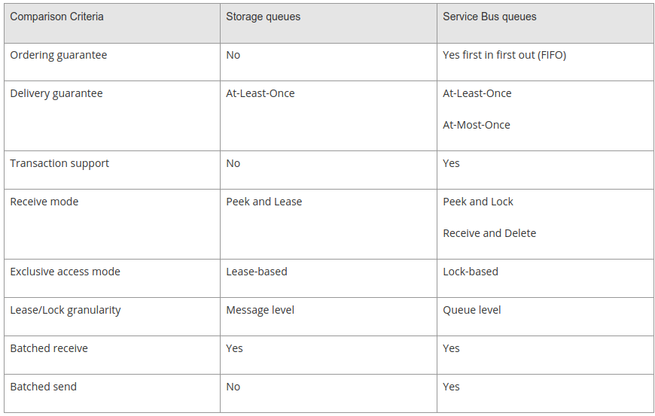
Module 5 Continued. . .
Azure Service Bus Queues > Service Bus Queues vs. Storage Queues

Slide 49
Module 5 Continued. . .
Azure Service Bus Queues > Service Bus Queues vs. Storage Queues
Ordering guarantee. Service Bus queues guarantee that messages are processed in a FIFO order. Storage queues do not guarantee this.
Delivery guarantee. Service Bus and Storage queues guarantee that messages are delivered at least once. Service Bus queues can also guarantee that a message is delivered only once.

Slide 50
Module 5 Continued. . .
Azure Service Bus Queues > Service Bus Queues vs. Storage Queues
Lease granularity. – Storage queues can set the lock/lease length to a different value for each individual message. Service Bus queues can set this value only for all the messages in a queue instance.
Batches. Both Storage and Service Bus queues can receive messages in a batch. Only Service Bus queues support batch creation of messages.

Slide 51
Module 5 Continued. . .
Azure Service Bus Relay > Overview
Service Bus relays provide a flexible way to connect WCF services and clients without having to redesign the network architecture in your organization. When you connect the WCF service to a relay in an outgoing manner, you clients will need to connect only to the Service Bus endpoint in Azure to communicate with your WCF service.
This module describes the benefits and architecture of Service Bus relays.

Slide 52
Module 5 Continued. . .
Azure Service Bus Relay > Service Bus Relay Overview
Service Bus includes a relay component that can connect existing services to new client applications without exposing the true location or address of the service. Supported services include Simple Object Access Protocol (SOAP), Web Services standards (WS*), and Representational State Transfer (REST). Some of the advantages of using a relay include: . . .

Slide 53
Module 5 Continued. . .
Azure Service Bus Relay > Service Bus Relay Overview
. . . WCF Services that need to communicate directly with external client applications or devices (For example, mobile devices) typically need to be placed in a special subnet or a virtual network with a unique NAT or firewall configuration. The address for the WCF endpoint will need to be publicly addressable in order for client devices to connect. In some enterprises, this can be considered dangerous or unacceptable. With Service Bus Relay, the WCF service makes an outbound connection to the relay and bypasses many of the complex network configurations that are necessary for inbound connections.

Slide 54
Module 5 Continued. . .
Azure Service Bus Relay > Service Bus Relay Overview
. . . Although mobile applications are deployed and updated regularly, end users might not update their applications as regularly as you want them to. If your WCF service needs to be migrated to a new network or moved to a new IP address, this can cause a lapse of connectivity for your mobile applications. Using Service Bus Relay, your mobile applications address a publically accessible and permanent uniform resource identifier (URI). You are then free to make changes and migrate your WCF service within your organization's infrastructure.

Slide 55
Module 5 Continued. . .
Azure Service Bus Relay > Service Bus Relay Overview
The new service instance or location simply needs to connect to the relay for client devices to access it. This enables more mobility for services that are connected to the applications that are already deployed.
Service Bus Relay also supports direct peer-to-peer communication. This is negotiated if the relay determines that the connecting application can easily and directly address the WCF service.

Slide 56
Module 5 Continued. . .
Azure Service Bus Relay > Service Bus Relay Overview
The Service Bus Relay service enables you to build hybrid applications that run in an Azure data center and in your own on-premises enterprise environment.
When you use Service Bus Relay, you must use a set of WCF bindings that are similar to the bindings that ship normally with WCF. These bindings include a relay prefix. They implement new binding elements that create a channel to your Service Bus instance in Azure.

Slide 57
Module 5 Continued. . .
Azure Service Bus Relay > Service Bus Relay Overview
. . . Bindings are included for one-way messages, request/response messages, and distributed event messages. The event messages are unique to Service Bus Relay and are used to enable a publish/subscribe scenario where your client applications can send a message and have that message distributed to multiple WCF service instances. For example, event messaging can be used to distribute a message to a receiver WCF service for processing and auditing a WCF service.

Slide 58
Module 5 Continued. . .
Azure Service Bus Relay > Service Bus Relay Overview
. . . Because Service Bus Relay utilizes bindings that are very similar to the traditional WCF bindings, many applications do not require large changes to use Service Bus Relay. The client applications typically require a new binding configuration that specifies the relay binding. After the client communicates with the relay, the relay service handles the targeting of messages to the appropriate WCF services. The client application does not need to know anything about the service's address or actual location. The service applications do not need to expose inbound ports on their firewall to receive these messages.

Slide 59
Module 5 Continued. . .
Azure Service Bus Relay > Service Bus Relay Overview
Benefits of Service Bus Relay
Flexible NAT configuration
Because the relay makes an outbound connection, you can use it in complex network environments where you would normally require changing your firewall for inbound connections.

Slide 60
Module 5 Continued. . .
Azure Service Bus Relay > Service Bus Relay Overview
. . . Benefits of Service Bus Relay
WCF
Relay is used with WCF services. WCF is a mature, stable messaging framework that supports both SOAP and REST messaging. WCF also has a mature ecosystem of custom bindings, behaviors, and components. SOAP and REST is also already widely supported by many existing services or client devices.

Slide 61
Module 5 Continued. . .
Azure Service Bus Relay > Service Bus Relay
VIDEO

Slide 62
Module 5 Continued. . .
Azure Service Bus Relay > Service Bus Relay Architecture
The Service Bus relay allows you to host WCF services within your existing enterprise environment. After you host, you can delegate the task of listening to incoming sessions and requests to the Service Bus service running within Azure. These messages are then routed to the appropriate WCF service. This enables you to expose these services to the application code that is running in Azure, or to mobile workers or extranet partner environments. Service Bus allows you to securely control who can access these services at a fine-grain level.

Slide 63
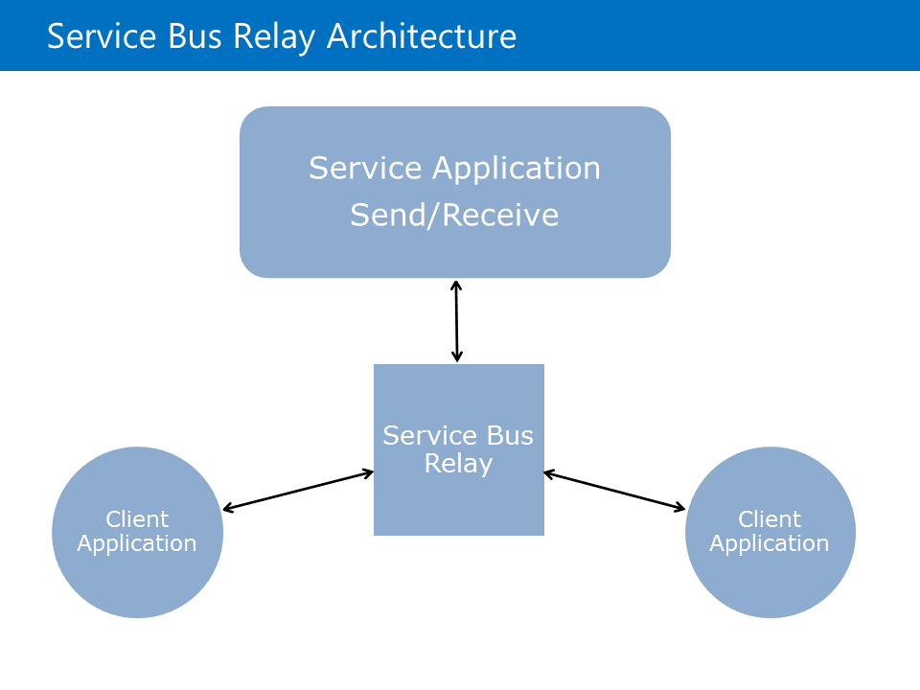
Module 5 Continued. . .
Azure Service Bus Relay > Service Bus Relay Architecture
. . . It provides a powerful and secure way to expose application functionality and data from your existing enterprise solutions and take advantage of it from the cloud.

Slide 64
Module 5 Continued. . .
Azure Service Bus Relay > Service Bus Relay Architecture
Incoming Relay Requests : When a client sends a request to Service Bus, the Azure load balancer routes it to any of the gateway nodes. If the request is a listening request, the gateway node creates a new relay. If the request is a connection request to a specific relay, the gateway node forwards the connection request to the gateway node that owns the relay. The gateway node that owns the relay sends a rendezvous request to the listening client, asking the listener to create a temporary channel to the gateway node that received the connection request.

Slide 65
Module 5 Continued. . .
Azure Service Bus Relay > Management Credentials
Management Credentials
Applications can authenticate to Service Bus by using Shared Access Signature (SAS) authentication. Previously, Azure Active Directory Access Control Service (ACS) was use to provide an access key
SAS authentication enables you to grant a user granular access to Service Bus resources with specific rights. SAS authentication in Service Bus involves the configuration of a cryptographic key with associated rights on a Service Bus resource.

Slide 66
Module 5 Continued. . .
Azure Service Bus Relay > Management Credentials
. . . Clients can then gain access to that resource by presenting a SAS token, which consists of the resource URI being accessed and an expiry signed with the configured key.
You can configure keys for SAS on a Service Bus namespace. The key applies to all messaging entities in that namespace. You can also configure keys on Service Bus queues, topics, and notification hubs. Support for Service Bus relays will be added in the near future. To use SAS, you can configure a SharedAccessAuthorizationRule object on a namespace, queue, topic, or notification hub . . .

Slide 67
Module 5 Continued. . .
Azure Service Bus Relay > Management Credentials
. . . that consists of the following:
KeyName that identifies the rule
PrimaryKey, a cryptographic key, which is used to sign or validate SAS tokens
SecondaryKey, a cryptographic key, which is used to sign or validate SAS tokens
Rights that represent the collection of Listen, Send, or Manage rights granted

Slide 68
Module 5 Continued. . .
Azure Service Bus Relay > Management Credentials
. . . Authorization rules configured at the namespace level can grant access to all the entities in a namespace for clients with tokens signed by using the corresponding key. You can configure up to 12 such authorization rules on a Service Bus namespace, queue, topic, or notification hub. By default, a SharedAccessAuthorizationRule object with all rights is configured for every namespace when it is first provisioned.

Slide 69
Module 5 Continued. . .
Azure Service Bus Notification Hubs > Overview
Notification Hubs provides a simple interface for a highly-scalable managed mobile push notification platform. By using Notification Hubs, an application can send template or personalized notifications across a variety of mobile platforms.
This module describes the Notification Hubs service and the methods of integrating with the service.

Slide 70
Module 5 Continued. . .
Azure Service Bus Notification Hubs > Service Bus Notification Hubs Overview
Service Bus Notification Hubs is a combination of a service infrastructure and a set of client libraries that allows you to publish push notifications to your mobile applications from any application service component. With Notification Hubs, you can send notifications that are personalized to a specific user, notifications that are distributed to many users across various platforms, and notifications that are filtered to a specific set of users.

Slide 71
Module 5 Continued. . .
Azure Service Bus Notification Hubs > Service Bus Notification Hubs Overview
. . . The Notification Hubs infrastructure abstracts the implementation of the various Platform Notification Systems (PNS) for each mobile platform. By using a single method call, you can send notifications to various device platforms without having to implement a different message structure or communication mechanism for each platform.
Notification hubs implement all the functionality of a push infrastructure.

Slide 72
Module 5 Continued. . .
Azure Service Bus Notification Hubs > Service Bus Notification Hubs Overview
You can use notification hubs in a variety of scenarios including:
Send wide-reaching news notifications to all devices with your mobile application installed
Send a notification to a subset of your users that is determined based on a tag, label, or location
Send specific notifications to a user for the activities that are related to their specific account

Slide 73
Module 5 Continued. . .
Azure Service Bus Notification Hubs > Benefits of using Notification Hubs
Notification hubs eliminate the challenges that are involved in managing push notifications. Notification Hubs use a full multiplatform, scaled-out push notification infrastructure, and considerably reduce the push-specific code that runs in the app. Notification hubs implement all the functionality of a push infrastructure. Devices are only responsible for registering PNS handles, and the backend is responsible for sending platform-independent messages to users or interest groups.

Slide 74
Module 5 Continued. . .
Azure Service Bus Notification Hubs > Benefits of using Notification Hubs
Notification hubs provide a push infrastructure with the following advantages:
Multiple platforms:
Support for all major mobile platforms, Windows, Windows Phone, iOS, and Android.
No platform-specific protocols. The application only communicates with Notification Hubs.
Device handle management. Notification Hubs maintains the handle registry and feedback from PNSs.

Slide 75
Module 5 Continued. . .
Azure Service Bus Notification Hubs > Benefits of using Notification Hubs
Works with any backend. Works with Cloud or on-premises applications that are written in .NET, PHP, Java, or Node.
Scale. Notification hubs scale to millions of devices without the need of rearchitecting or sharding.
Rich set of delivery patterns. Associate devices with tags, representing logical users or interest groups.
. . . . . . . .

Slide 76
Module 5 Continued. . .
Azure Service Bus Notification Hubs > Benefits of using Notification Hubs
. . . Broadcast. Allows for near-simultaneous broadcast to millions of devices with a single Application Programming Interface (API) call.
Unicast/Multicast. Push to tags representing individual users, including all their devices; or a wider group. For example, a user could use the app on separate devices (tablet, phone, etc.) and would require push notifications to either be pushed to all devices or a specific device.
Segmentation. Push to a complex segment that is defined by tag expressions (For example, devices in New York following the Yankees).

Slide 77
Module 5 Continued. . .
Azure Service Bus Notification Hubs > Benefits of using Notification Hubs
Personalization. Each device can have one or more templates to achieve per-device localization and personalization without affecting the backend code.

Slide 78
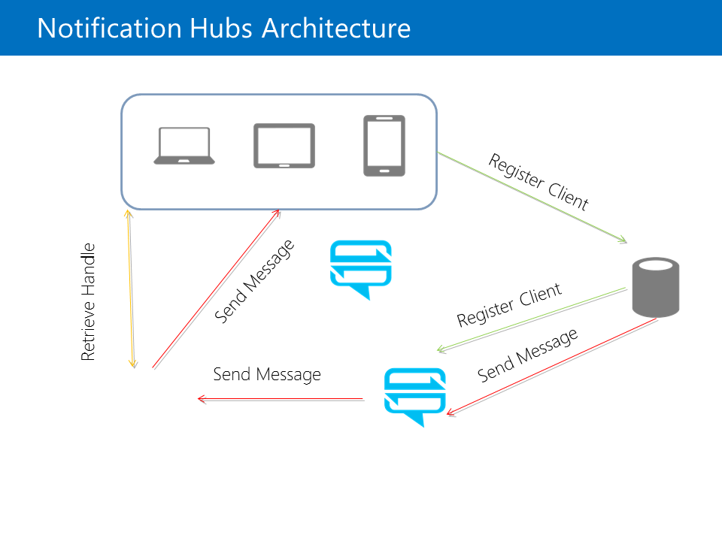
Module 5 Continued. . .
Azure Service Bus Notification Hubs > Notification Hubs Architecture
1. The client application contacts the PNS to retrieve its handle. The handle type depends on the system. For Windows Notification Service (WNS), it is a URI or notification channel. For Apple Push Notification Service (APNS), it is a token.

Slide 79
Module 5 Continued. . .
Azure Service Bus Notification Hubs > Notification Hubs Architecture
2. The client application stores this handle in the app backend for later usage. For WNS, the backend is typically a cloud service. For APNS, the system is called a provider.
3. To send a push notification, the app backend contacts the PNS by using the handle to target an instance of a specific client application.
4. The PNS forwards the notification to the device specified by the handle.

Slide 80
Module 5 Continued. . .
Azure Service Bus Notification Hubs > Notification Hubs Architecture
With Notification Hubs, you can rely on the service infrastructure to handle the most complex features and have your application focus only on sending messages.
Notification hubs implement all the functionality of a push infrastructure.
Notification Hubs can be used in flexible ways to register devices and eventually send a message to the devices.

Slide 81
Module 5 Continued. . .
Azure Service Bus Notification Hubs > Notification Hubs Architecture
Devices can register themselves and receive notifications using the following method:
1. The client device reaches out to the PNS by using the Notification Hubs SDK. It registers a unique PNS handle that is used by the service to send notifications to this device whether the application is running or not.
2. The client device can alternatively send its PNS handle to the application backend to have the application register the device.

Slide 82
Module 5 Continued. . .
Azure Service Bus Notification Hubs > Notification Hubs Architecture
3. When the application backend sends a message to the Notification Hubs service, the service handles sending the message to the appropriate target clients by using their registered PNS handles. The application backend simply requests the message is sent and the Notification Hubs service and the PNS handle the actual distribution of messages to client devices.

Slide 83
Module 5 Continued. . .
Azure Service Bus Notification Hubs > Registrations
A registration is a sub entity of a notification hub, and associates a device PNS handle—For example, ChannelURI, device token, or Google Cloud Messaging (GCM) registrationId with tags and possibly a template. Tags are used to route notifications to the correct set of device handles. Templates are used to implement per-registration transformation.
Registrations are temporary by default. They can be set to a maximum of 90 days. This can affect the way you design your application and the registration method you select for Notification Hubs.

Slide 84
Module 5 Continued. . .
Azure Service Bus Notification Hubs > Registrations
. . . Registrations must contain the most recent PNS handle for each device or channel. Because PNS handles can be obtained only in the client app on the device, one way to manage registrations is to directly register with the Notification Hubs provider on the client app. On the other hand, the security considerations and business logic that is related to the tags might require you to manage the registration in the app backend.

Slide 85
Module 5 Continued. . .
Azure Service Bus Notification Hubs > Registrations
Application Backend Registration
Managing registrations from the backend requires writing additional code. The app from the device must provide the updated PNS handle to the backend every time the app starts (along with tags and templates), and the backend must update this handle on Service Bus.

Slide 86
Module 5 Continued. . .
Azure Service Bus Notification Hubs > Registrations
. . . The advantages of managing registrations from the backend are the ability to modify tags to registrations even when the corresponding app on the device is inactive, and to authenticate the client app before adding a tag to its registration. From your app backend, you can perform basic Create, Read, Update and Delete (CRUD) operations on registrations.

Slide 87
Module 5 Continued. . .
Azure Service Bus Notification Hubs > Registrations
Client Registration
When managing registrations from client apps, the backend is responsible only for sending notifications. Client apps keep the PNS handles up to date and register to tags. The mobile device first retrieves the PNS handle from the PNS, and then registers with the notification hub directly. After the registration is successful, the app backend can send a notification targeting that registration.

Slide 88
Module 5 Continued. . .
Azure Service Bus Notification Hubs > Registrations
. . . The drawback to client registration is that a client app can only update its tags when the app is active. For example, if a user has two devices that register tags that are related to sport teams, when the first device registers for an additional sports team, the second device will not receive the notifications about that team until the app on the second device is run a second time. Generally, when tags are affected by multiple devices, managing tags from the backend is a desirable option.

Slide 89
Module 5 Continued. . .
Azure Service Bus Notification Hubs > Message Templates and Tags
Not all messages sent to a notification hub are intended to be distributed to all device platforms or types and all devices. You can use templates to translate a message into the appropriate structure and format that is compatible with each platform and mobile operating system. You can use tags to filter target devices for a message.

Slide 90
Module 5 Continued. . .
Azure Service Bus Notification Hubs > Message Templates and Tags
Templates
Templates enable a client application to specify the exact format of the notifications it wants to receive. For example, the following two payloads are used for Windows and Apple mobile devices:
Notification format for APNS (Apple Platform Notification Service)

Slide 91
Module 5 Continued. . .
Azure Service Bus Notification Hubs > Message Templates and Tags
Not all messages sent to a notification hub are intended to be distributed to all device platforms or types and all devices. You can use templates to translate a message into the appropriate structure and format that is compatible with each platform and mobile operating system. You can use tags to filter target devices for a message.

Slide 92
Module 5 Continued. . .
Azure Service Bus Notification Hubs > Message Templates and Tags
APNS JSON payload
{“aps”: {“alert” : “Hello!” }}
. . . . .

Slide 93
Module 5 Continued. . .
Azure Service Bus Notification Hubs > Message Templates and Tags
Notification format for WNS (Windows Notification Service)
WNS XML payload
<toast>
<visual>
<binding template=\"ToastText01\">
<text id=\"1\">Hello!</text>
</binding>
</visual>
</toast>

Slide 94
Module 5 Continued. . .
Azure Service Bus Notification Hubs > Message Templates and Tags
This requirement forces the app backend to produce different payloads for each platform. This becomes a problem when you consider graphical layouts and localization. The Notification Hubs template feature enables a client app to create special registrations, called template registrations, which include a template in addition to the set of tags. The template is then used to translate a message into the appropriate format or structure for each device.

Slide 95
Module 5 Continued. . .
Azure Service Bus Notification Hubs > Message Templates and Tags
. . . A template is a set of instructions for the notification hub to format a platform-independent message to the format that is appropriate for each device.

Slide 96
Module 5 Continued. . .
Azure Service Bus Notification Hubs > Message Templates and Tags
Tags
Tag expressions enable you to target specific sets of devices, or more specifically registrations, when you send a push notification through Notification Hubs. A tag can be any string, up to 120 characters, that contains alphanumeric characters. The only way to target specific registrations is to associate them with a tag, and then target that tag.

Slide 97
Module 5 Continued. . .
Azure Service Bus Notification Hubs > Message Templates and Tags
The application backend can choose the registrations to target with a specific notification in the following ways:
Broadcast. All registrations in the notification hub receive the notification
Tag. All registrations that contain the specified tag receive the notification
Tag expression. All registrations whose set of tags match the specified expression receive the notification

Slide 98
Module 5 Continued. . .
Azure Service Bus Notification Hubs > Message Templates and Tags
Tags do not have to be pre-provisioned and can refer to multiple app-specific concepts. There are cases in which a notification has to target a set of registrations that is identified not by a single tag, but by a Boolean expression on tags. Tag expressions can contain all Boolean operators, such as AND (&&), OR (||), and NOT (!). They can also contain parentheses. Tag expressions are limited to 20 tags if they contain only ORs; otherwise they are limited to 6 tags.

Slide 99
Module 5 Continued. . .
Azure Service Bus Notification Hubs > Message Templates and Tags
You can use tag expressions to target many possible matching tags instead of a single tag.
Tag Expression
(follows_RedSox || follows_Cardinals) && location_Boston
The following example shows an application from which you can receive toast notifications about specific music groups. In this scenario, a simple way to route notifications is to label registrations with tags that represent the different bands.

Slide 100
Module 5 Continued. . .
Azure Service Bus Notification Hubs > Notification Hub Templates and Tags
VIDEO

Slide 101
Module 5 Continued. . .
Lab: Using Queues and Service Bus to Manage Communication Between Web Applications in Azure
Lab: Using Queues and Service Bus to Manage Communication Between Web Applications in Azure

